Slide 1


Slide 2
What is An Algorithm ?
Definition :
A finite, clearly specified sequence of instructions to be followed to solve a problem.

Slide 3
Properties of an algorithm
Effectiveness
􏰀 simple
􏰀 can be carried out by pen and paper
Definiteness
􏰀 clear
􏰀 meaning is unique

Slide 4
Properties of an algorithm
Correctness
􏰀 give the right answer for all possible cases
Finiteness 􏰀 stop in reasonable time

Slide 5
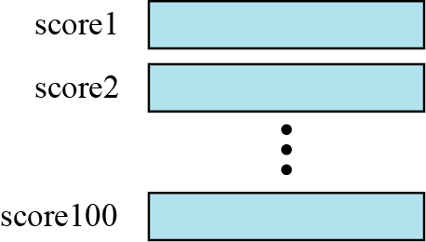
ARRAYS
Imagine that we have 100 scores. We need to read them, process them and print them. We must also keep these 100 scores in memory for the duration of the program. We can define a hundred variables, each with a different name, as shown in Figure below
Figure 1.1 A hundred individual variables

Slide 6
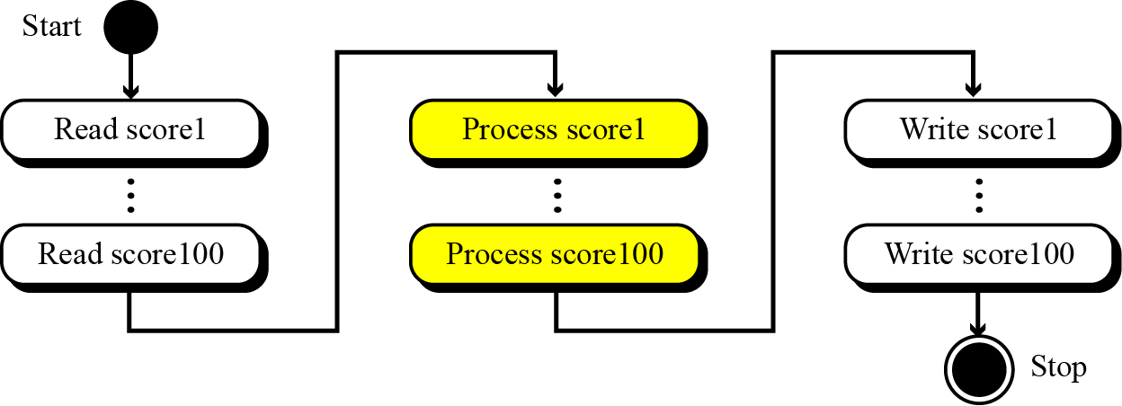
But having 100 different names creates other problems. We need 100 references to read them, 100 references to process them and 100 references to write them. Figure below shows a diagram that illustrates this problem.
Fig. 1.2 Processing individual variables

Slide 7
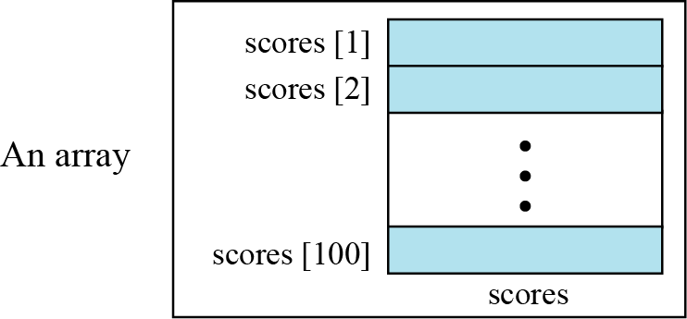
An array is a sequenced collection of elements, normally of the same data type, although some programming languages accept arrays in which elements are of different types.
We can refer to the elements in the array as the first element, the second element and so forth, until we get to the last element.
Fig. 1.3 Arrays with indexes

Slide 8

We can use loops to read and write the elements in an array. We can also use loops to process elements. Now it does not matter if there are 100, 1000 or 10,000 elements to be processed—loops make it easy to handle them all. We can use an integer variable to control the loop and remain in the loop as long as the value of this variable is less than the total number of elements in the array .
i
We have used indexes that start from 1; some modern languages such as C,
C++ and Java start indexes from 0.

Slide 9
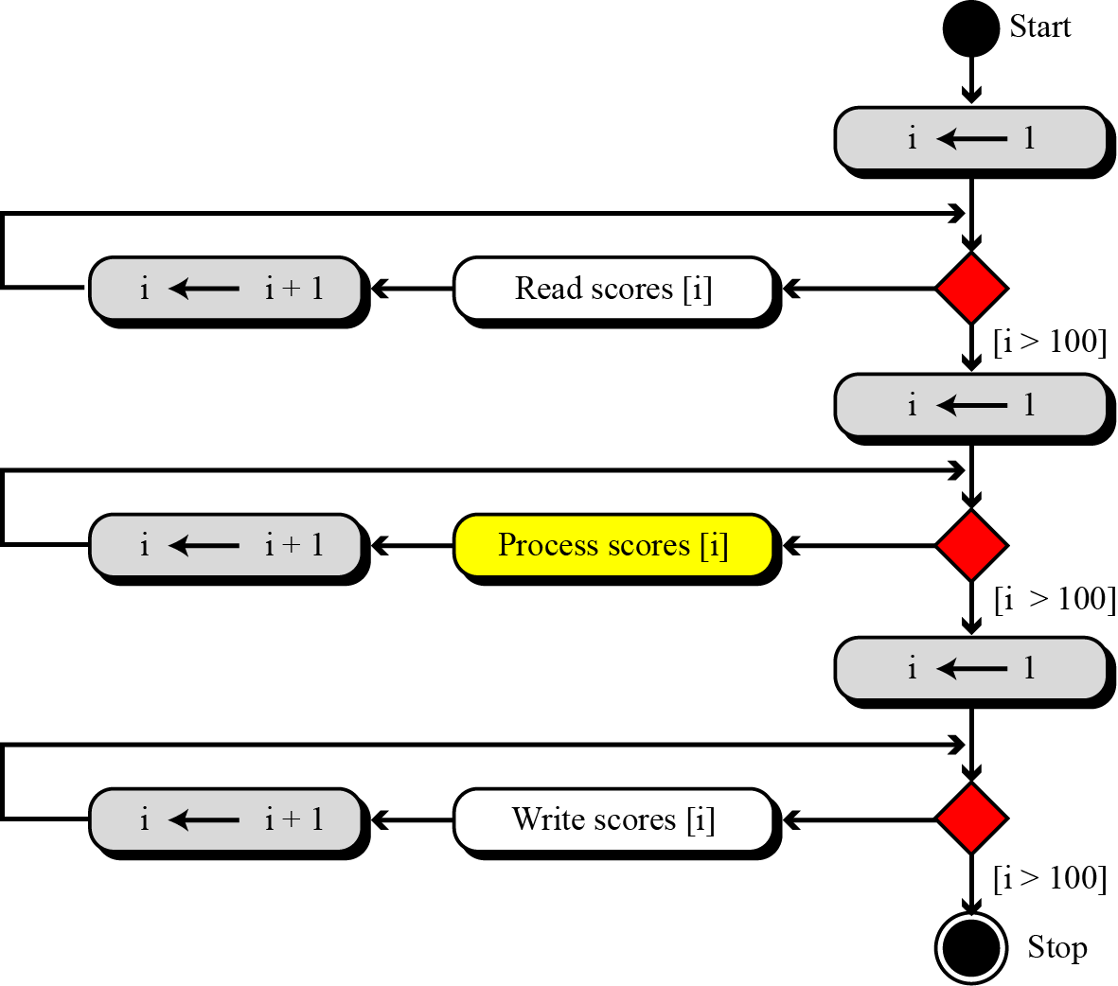
Fig. 1.4 Processing an array

Slide 10
Example
Compare the number of instructions needed to handle 100 individual elements in Figure 1.3 and the array with 100 in Figure 1.4. Assume that processing each score needs only one instruction.
Solution
❑ In the first case, we need 100 instructions to read, 100 instructions to write and 100 instructions to process. The total is 300 instructions.
❑ In the second case, we have three loops. In each loop we have two instructions, for a total of six instructions. However, we also need three instructions for initializing the index and three instructions to check the value of the index. In total, we have twelve instructions.

Slide 11
Example
The number of cycles (fetch, decode, and execute phases) the computer needs to perform is not reduced if we use an array. The number of cycles is actually increased, because we have the extra overhead of initializing, incrementing and testing the value of the index. But our concern is not the number of cycles: it is the number of lines we need to write the program.

Slide 16
Representation of Linear Array in Memory
To calculate the address of any element of LA the formula is:
Loc(LA[K]) = Base [LA] + w(K – Lower bound)
where
Loc(LA[K]) = address of the element LA[K] of the array LA
Base[LA] is the first element of the array
W is the number of memory cell each element occupied or the word size
Lower bound is the index of the first element of the array
K is the address of the array element

Slide 18
Example
Suppose an array ST is used to store the no. of students enrolled in BUK since 1984 to 2017 . The array ST is picture below:
Find
a) Base (ST) b) Word size(w) c) Loc[1995]
d) Loc[2016] e) The lower bound of ST
f) The upper bound of ST
g) Number of element of ST

Slide 19
Traversing
let A be a collection of data elements stored in the memory of the computer
Suppose we want to either print the contents of each element of A or to count the number of elements of A with a given property.
This can be accomplished by traversing A, that is, by accessing and processing (frequently called visiting) each element of A exactly once.
Notes:
Consider let A be a collection of data elements stored in the memory of the computer. Suppose we want to either print the contents of each element of A or to count the number

Slide 20
This algorithm traverses LA applying an operation PROCESS to each element of LA.
Notes:
This algorithm traverses LA applying an operation PROCESS to each element of LA.

Slide 23
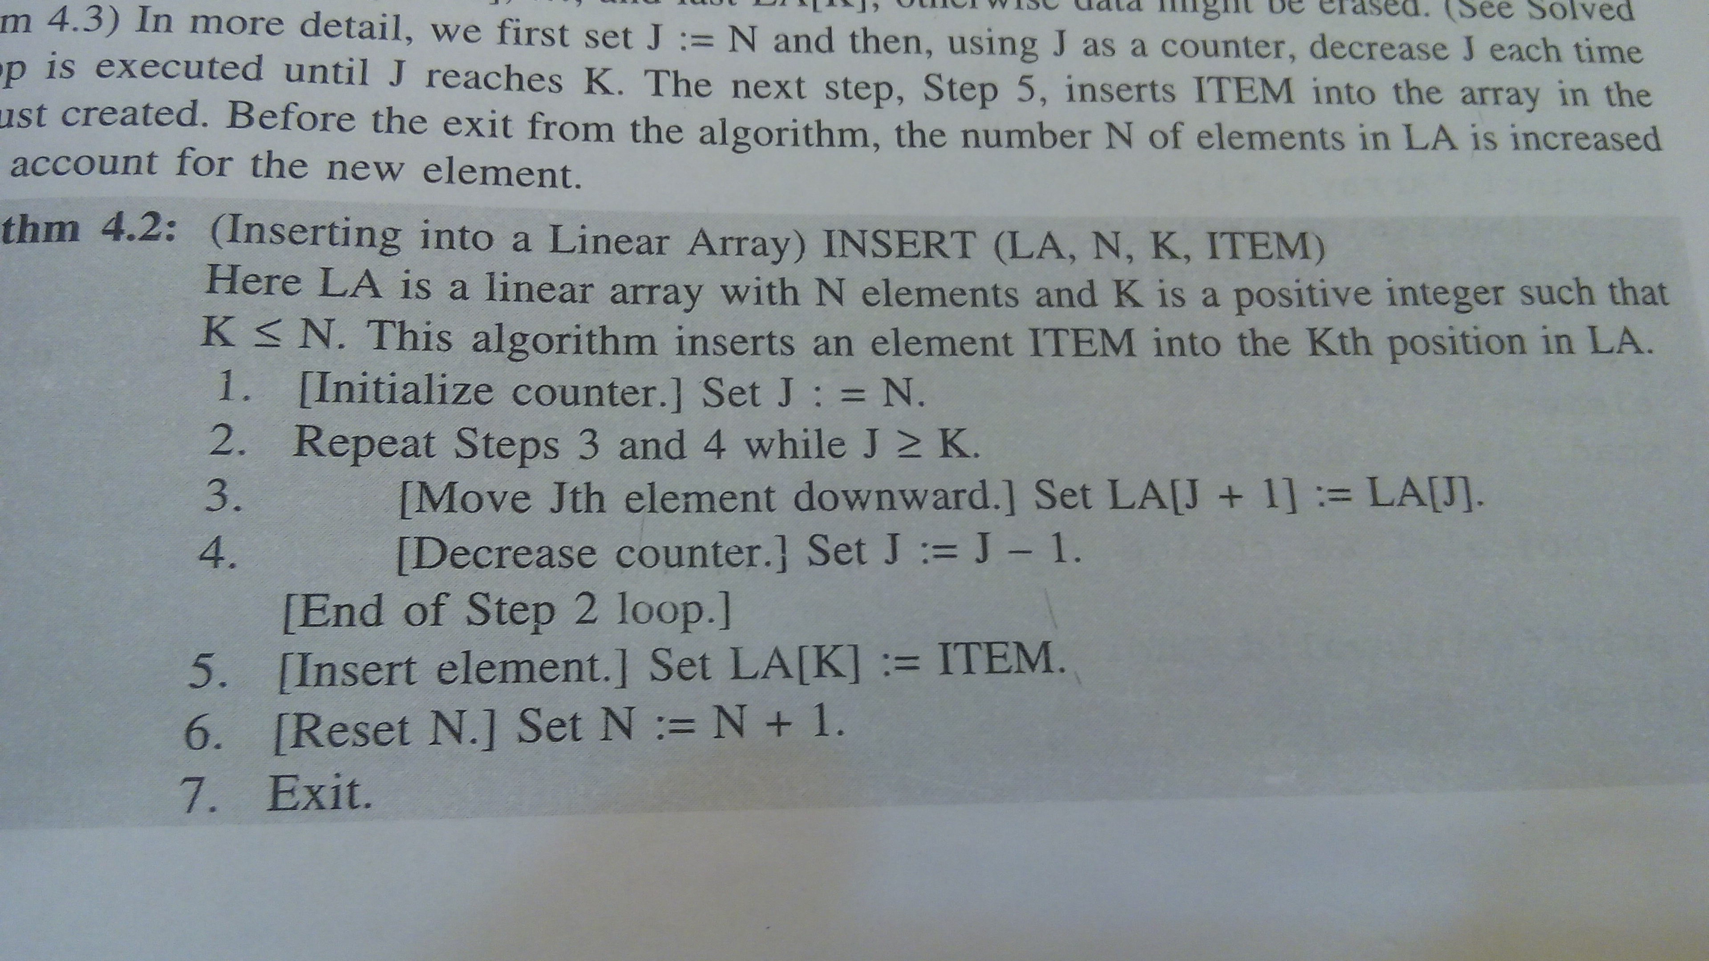
Inserting Algorithm

Slide 24
The above algorithm deletes the Kth element from a linear array LA and assigns it to a variable ITEM i.e. DELETE{LA.N,K,ITEM).

Slide 25
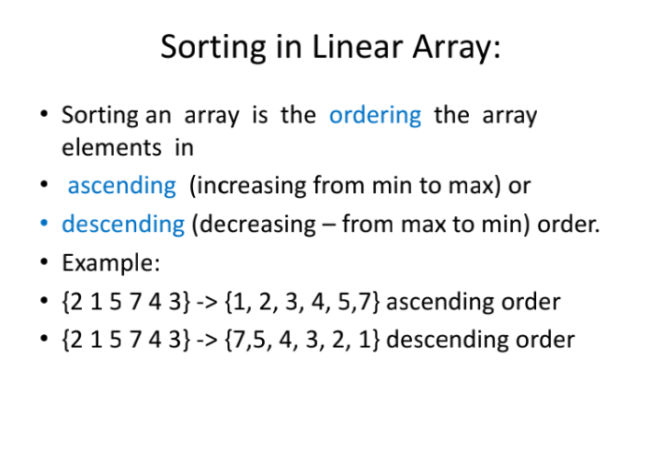

Slide 26
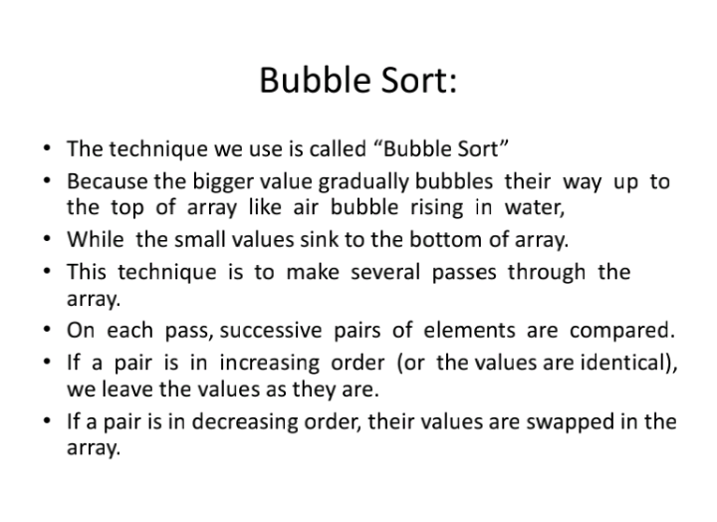

Slide 27
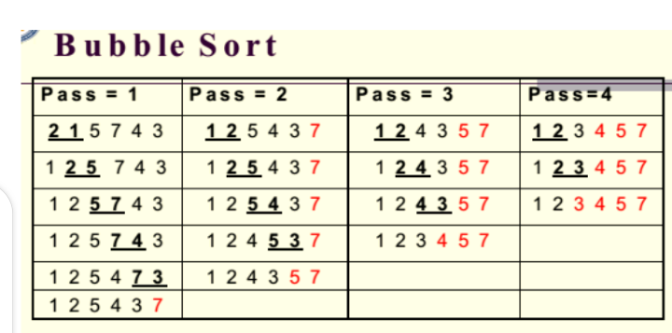

Slide 28
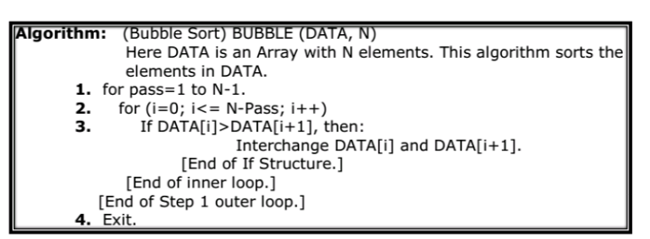

Slide 29
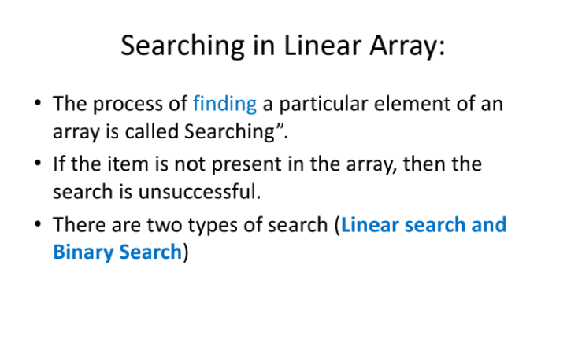

Slide 30
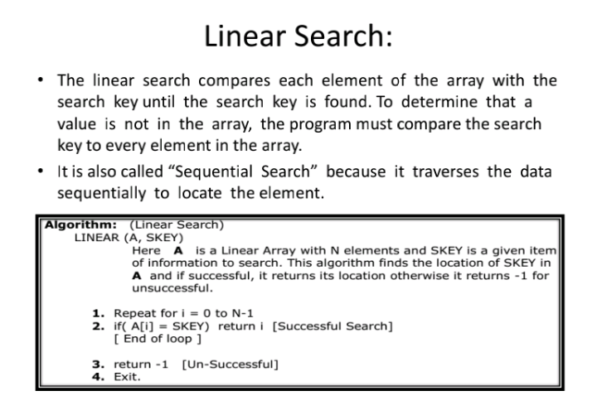

Slide 31
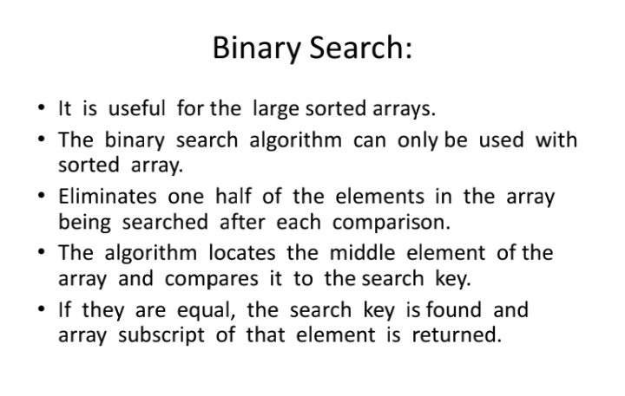

Slide 32
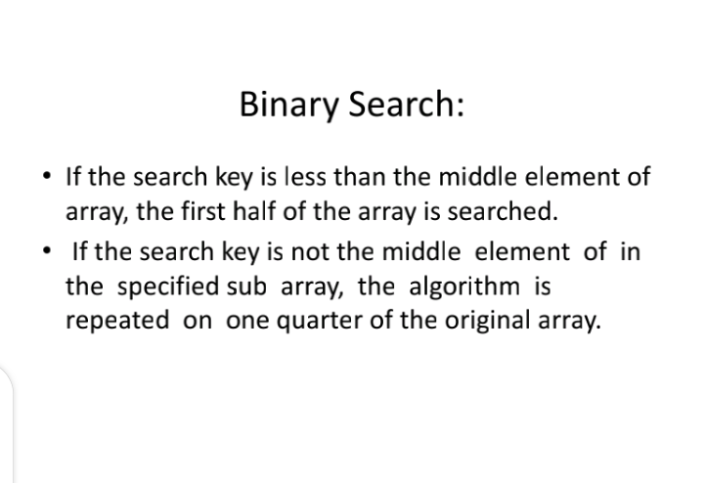

Slide 33
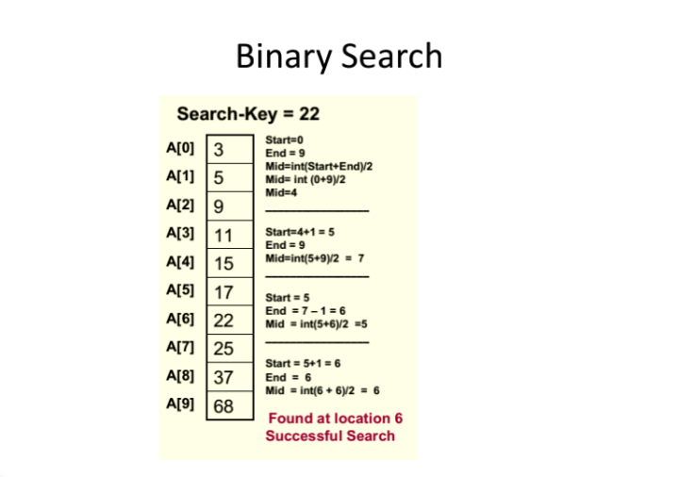

Slide 34
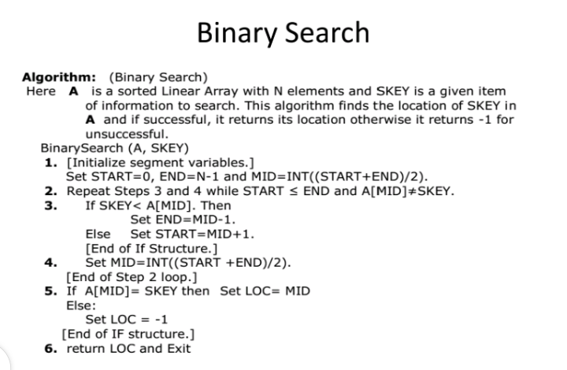

Slide 35
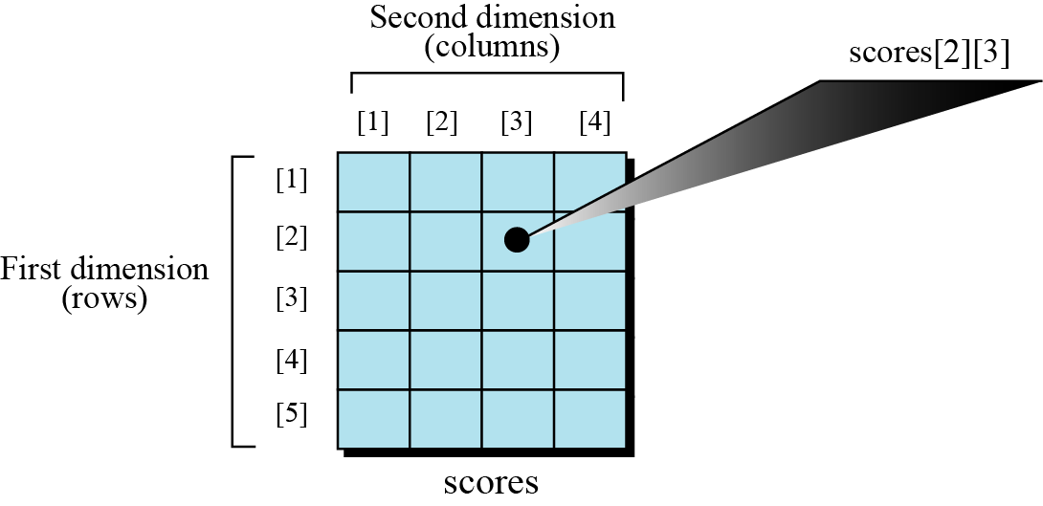
Multi-dimensional arrays
The arrays discussed so far are known as one-dimensional arrays because the data is organized linearly in only one direction. Many applications require that data be stored in more than one dimension. Figure below shows a table, which is commonly called a two-dimensional array. In fact, some programming languages allow the number of dimensions for an array to be high as 7.
A two-dimensional array

Slide 36
Two dimensional array
Two-dimensional arrays are called matrices in mathematics and tables in business applications;
Hence , two-dimensional arrays are called matrix arrays.
It is most common to index this array using the RC-convention, where elements are referred in row, column fashion
Let A be a two–dimensional m x n array.
The first dimension of A contains the index set 1,......., m. with lower bound 1 and upper bound m.
The second dimension of A contains the index set 1,2,..... n, with lower bound 1 and upper bound n.
The pair of lengths m x n (read “m by n”) is called the size of the array.

Slide 37
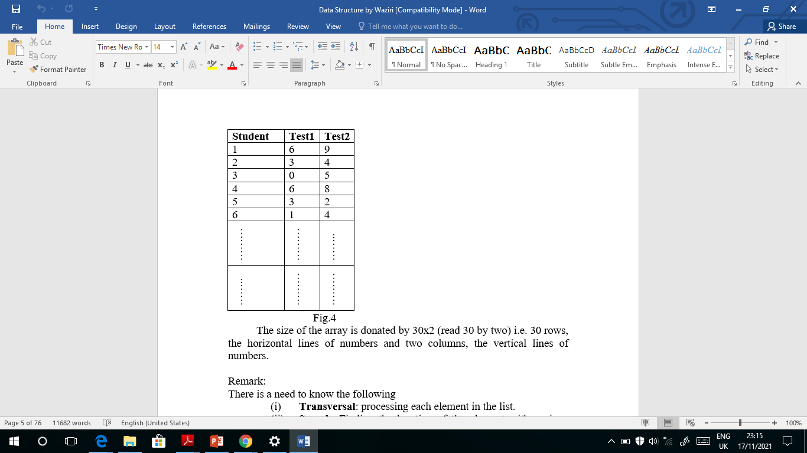
Example
A course lecturer in Computer Science Dept. teaching CSC2310 offered by 30 students after given two C.A test. The record for the C.A can be store in computer by use of two dimensional arrays, in which the first subscript donates the student and the second subscript donates the test number.

Slide 38
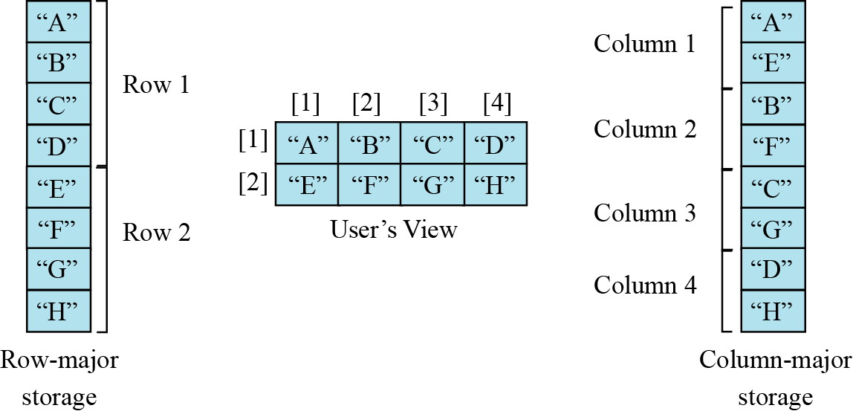
Representation of two dimensional array in memory
The indexes in a one-dimensional array directly define the relative positions of the elements in actual memory.
Multi-dimensional arrays can be stored as linear arrays in order to reduce the computation time and memory.
The Figure below shows a two-dimensional array and how it is stored in memory using row-major or column-major storage. Row-major storage is more common.
.
Memory layout of arrays

Slide 39
For a linear array LA, the computer does not keep track of the address LOC(LA[K]) of every element LA[K] of LA, but does keep track of Base(LA), the address of the first element of LA.
The computer uses the formula below to find the address of LA[K] .
LOC(LA[K]) = Base(LA) + w (K-1)
w is the number of words per memory cell for the
array LA, and 1 is the lower bound of the index set of LA.
A similar situation also holds for any two-dimensional m x n array A.
That is, the computer keeps track of Base(A) – the address of the first element A[1,1] of A – and computes the address LOC(A[J, K]) of A[J, K].

Slide 40
column major order formula
LOC(A[J, K]) = Base(A) + w[M(K-1) + (J-1)]

Slide 41
Raw major order formula
LOC(A[J, K]) = Base(A) + w[N(J-1) + (K-1)]

Slide 42
Example 11.4
We have stored the two-dimensional array students in memory. The array is 100 × 4 (100 rows and 4 columns). Show the address of the element students[5][3] assuming that the element student[1][1] is stored in the memory location with address 1000 and each element occupies only one memory location. The computer uses row-major storage.
Solution
.
If the first element occupies the location 1000, the target element occupies the location 1018.

Slide 43
Operations on array
Although we can apply conventional operations defined for each element of an array , there are some operations that we can define on an array as a data structure. The common operations on arrays as structures are searching, insertion, deletion, retrieval and traversal.
Although searching, retrieval and traversal of an array is an easy job, insertion and deletion is time consuming. The elements need to be shifted down before insertion and shifted up after deletion.

Slide 44
Application
Thinking about the operations discussed in the previous section gives a clue to the application of arrays. If we have a list in which a lot of insertions and deletions are expected after the original list has been created, we should not use an array. An array is more suitable when the number of deletions and insertions is small, but a lot of searching and retrieval activities are expected.

Slide 45
THANK YOU

